Slide 1



UNMASKING THE NUMBERS:
Revolutionizing Data Retrieval
GROUP 6

Slide 2

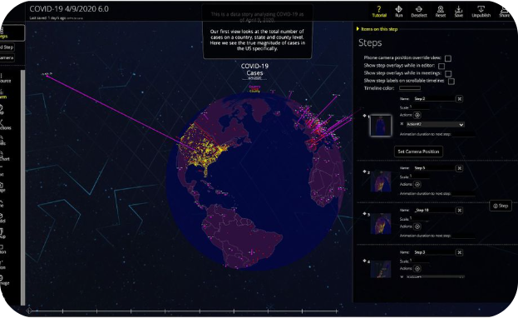
The Power of APIs: Relevant Data at Your Fingertips
Numbers API
COVID-19 APIs
A treasure trove of trivia.
Real-time insights into the global pandemic, country by country.

Slide 3
Project Overview
This project presents a powerful integration of the Numbers API and a COVID-19 Tracker
App, providing users with a comprehensive tool to explore numerical trivia and real-time
Covid-19 statistics.
This console app is nothing short of incredible. With interactive features that adjust based
on your response or command, it offers a powerful and intuitive experience to everyone
interested in staying informed about the global pandemic.
The integration is seamless and efficient, making it the perfect tool for keeping up-to-date with
the latest COVID-19 updates and a number trivial by the side.

Slide 4
s
Problem Statement
Many individuals and organizations struggle to access and interpret data from public APIs such as the Numbers API and the COVID-19 API.
This lack of accessibility and understanding hinders their ability to gain insights from the available data. Our console application provides a user-friendly interface that allows easy access to information from these APIs.
With our application, users can effortlessly retrieve and interpret data from the Numbers API, gaining access to interesting historical facts, and from the COVID-19 API, enabling them to stay informed about the latest global and country-specific COVID-19 statistics.
Our application aims to bridge the gap between the valuable data provided by these APIs and the users who can benefit from it, ultimately empowering them to make more informed decisions and gain valuable insights.

Slide 5
Unleashing the Code
Major Function for the app
Imports of URL
if __name__ == "__main__":
while True:
print(
"""
Welcome to the Group 6 Python Console App.
Please choose which API you want to use.
1 - Numbers App
2 - COVID-19 App
3 - Exit Program
"""
)
A continuous loop for “y” is done, and input is case-sensitive,
in the event of an error, it runs this code and sends you back to the main welcome note.
elif tmp == "3":
print("Exiting program.")
break
Imports and def of URL and JSON files
from urllib.request import urlopen
from datetime import datetime
import json
def numbersapi_url():
BASE_URL_1 = "http://numbersapi.com/"
Numbers conversion from str to int
month = int(input("Enter a month(1-12): "))
day = int(input("Enter a day(1-31): "))
url = BASE_URL_1 + str(month) + "/" + str(day) + "/date"
In the event of an error in the input, it Breaks and exits to the main
Welcome note
ISO was used to ensure the readability and consistency of dates and times

Slide 6
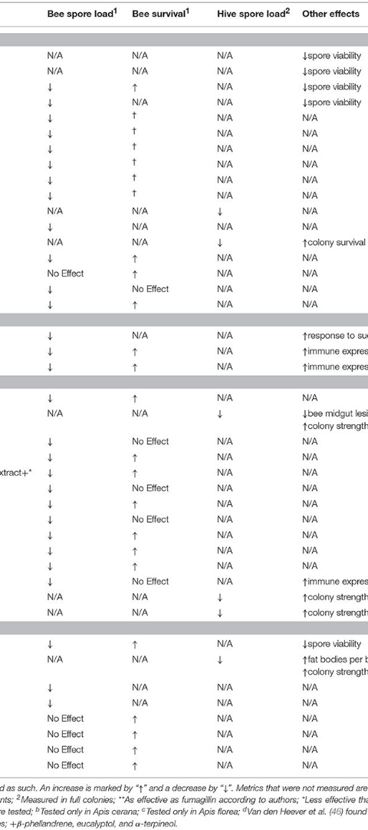
Why We Chose the Numbers API and Covid 19 API
Data Focus
Data Customization
The Numbers API primarily focuses on mathematical and statistical data, while the Covid 19 API centers around pandemic-related information.
Numbers API allows for customization of retrieved data, whereas Covid 19 API emphasizes real-time and standardized data access.
Usage Scenarios
We can use the Numbers API for educational, research, and trivia purposes, while the Covid-19 API is essential for tracking and analyzing pandemic data .Users can input a month and day to get data from the Numbers API or choose between global or country data for the COVID-19 App. .

Slide 7
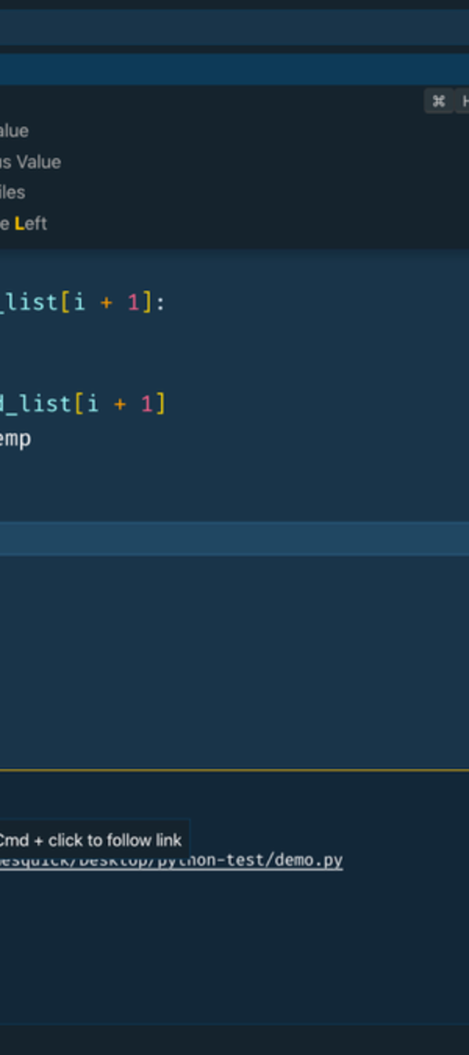

Code Structure
1
Numbers API
The code starts with the definition of the numbersapi_url function, which fetches data from the Numbers API based on user input for month and day.
2
Covid 19 API
The get_data function fetches data from the COVID-19 API based on user input for date and country ISO code. The covid19 function is the main function for the COVID-19 App, which displays a menu and calls the get_data function for both global and country data.
3
Main Function
The main function is the main function for the project, which runs indefinitely and calls the numbersapi_url and covid19 functions.

Slide 8
Overview of Numbers and COVID-19
API features
1
Data Retrieval
These APIs provide easy access to a wide range of mathematical facts, trivia, and statistical data.
2
Customization
We can customize the data returned by the Covid-19 API to suit their specific requirements, enabling tailored information retrieval.
3
Error Handling
The API offers comprehensive error handling, ensuring that developers can gracefully manage unexpected data retrieval issues.

Slide 9
Benefits of the Console APP
Real-time Data
Data Visualization
Geographical Information
The Covid 19 API provides up-to-date information on the global pandemic, including statistics, case counts, and country data.
Developers can use the API to access data for creating interactive visualizations and dashboards to present pandemic-related data.
The API offers geographical data related to COVID-19, including regional case counts.
Data Retrieval
Data Analysis
Use the COVID-19 API to retrieve real-time data on the status of the pandemic, including case counts and vaccination rates.
Process and analyze the retrieved data to identify trends, patterns, and areas of specific concern related to the pandemic.

Slide 10
Work Done
We got the URL for the Numbers API from the website; http://numbersapi.com/,.
We got the URL for the Covid-19 API from the website; https://covid-api.com/api/
We defined the functions for the APIs on VS Code
We worked on integrating the two APIs to work concurrently. This is so that data can be obtained about the Covid-19 pandemic as interesting facts about the matching dates are also gotten using the numbers API.
The application is designed to run indefinitely, allowing users to continue using either app as long as they wish.
We completed the project by cloning the git repository, using:
git clone https://github.com/SeyAnnie/Group_-6_Consoleapp.git

Slide 11
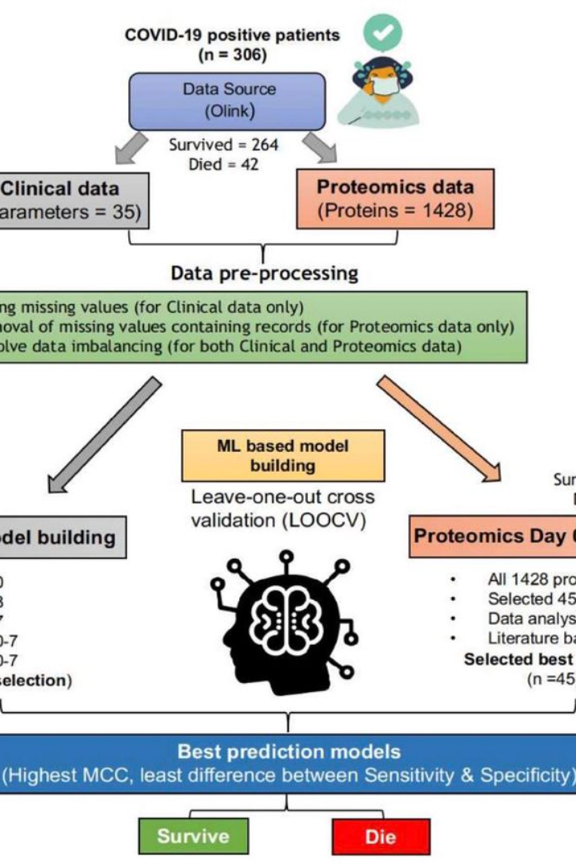
Collaborators
Precious Nnodi
Onyinye Alago
Favor Alozie
Aniedi Bassey
Sherifat Sanni
Vessina Udoh
Adeola Adeagbo

Slide 12
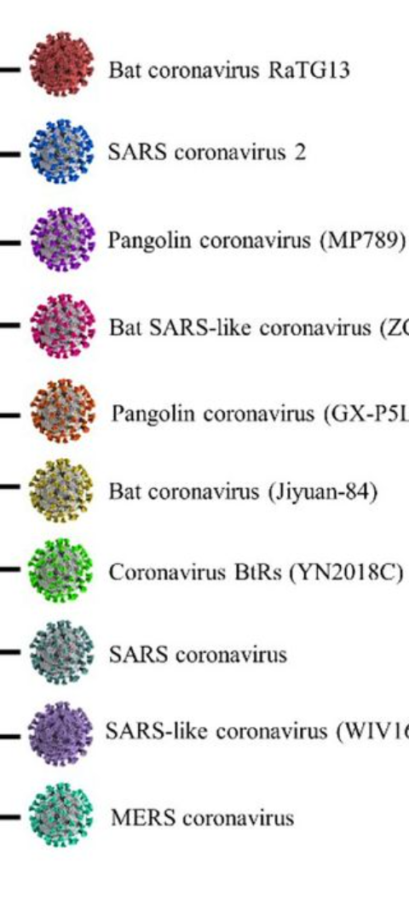
Beyond the Numbers: Telling Stories with Data
1
Identifying Patterns and Trends
2
Data Storytelling
Using data to answer questions, raise awareness, and inform decision-making.
Providing context and understanding of the pandemic through data.

Slide 13
s
THANK YOU

